Slide 1
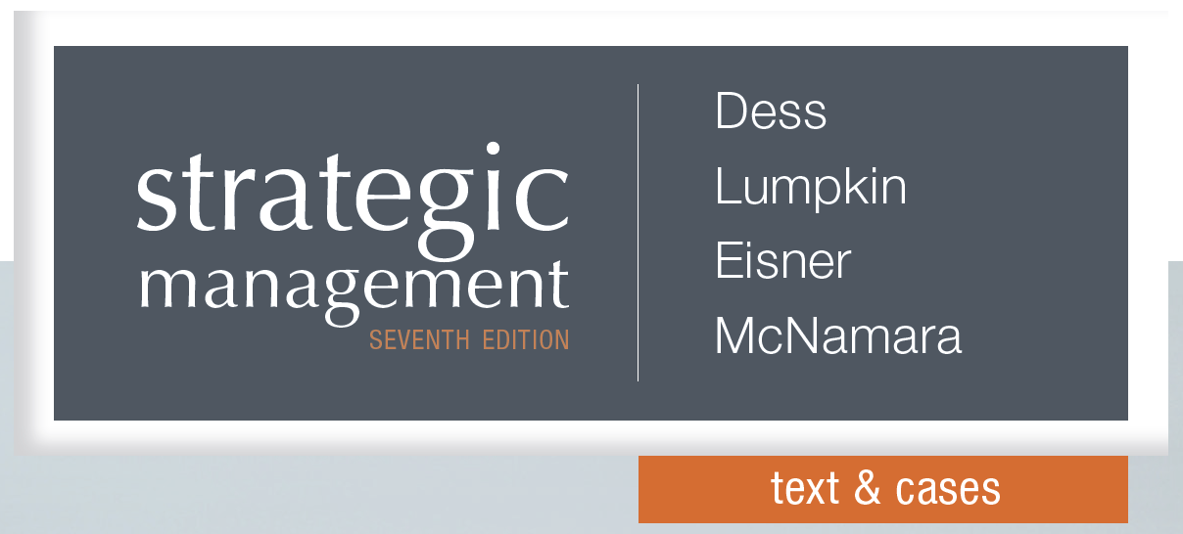

Analyzing Strategic Management Cases
chapter 13

Slide 2
Strategic Case Analysis
  Why do some firms succeed and others fail?
  Why are some companies higher performers than others?
  What information is needed in the strategic planning process?
  How do competing values and beliefs affect strategic decision-making?
  What skills and capabilities are needed to implement a strategy effectively?
Notes:
The process of analyzing, decision-making, and implementing strategic actions raises many good questions. Case analysis simulates the real world experience that strategic managers and company leaders face as they try to determine how best to run their companies. Case analysis = a method of learning complex strategic management concepts – such as environmental analysis, the process of decision-making, and implementing strategic actions – through placing students in the middle of an actual situation and challenging them to figure out what to do. As one CEO said “if you don’t ask the right questions, then you’re never going to get the right solution.” Case analysis forces you to choose among different options and set forth a plan of action, a potential solution, based on your choices. But even then the job is not done. Strategic case analysis also requires that you address how you will implement the plan and the implications of choosing one course of action over another.

Slide 3
Strategic Case Analysis
Strategic management cases include
  A detailed description of the challenging situation faced by an organization
  Usually includes a chronology of events
  Can include financial statements, product lists, interviews with employees
Strategic case analysis requires
  An ability to evaluate business situations
  Go beyond the textbook & root out essential issues and causes of a company’s problems
Notes:
One of the main reasons to analyze strategic management cases is to develop an ability to evaluate business situations critically. Just as organizational leaders and managers must analyze the overall environment, make decisions about how to compete, and then design the organization in order to implement these decisions and take required action, students must analyze the issues, choose among different options, and set forth a plan of action based on their choices. Students must go beyond memorizing key terms and conceptual frameworks. Case analysis requires a deep look into the information that is provided, and then the ability to root out the essential issues and causes of a company’s problems.

Slide 4
Strategic Case Analysis: Skills
Strategic skills needed include the ability to differentiate:
  Evaluate many different elements of the situation at once
  Differentiate between the factors that are influencing the situation
  Understand that problems are often complex & multilayered
    Need to dig deep
    Don’t be too quick to accept an easy solution
Notes:
Case analysis adds to the overall learning experience by helping students acquire or improve skills that may not be taught in a typical lecture course. Three capabilities that can be learned by conducting case analysis are specially useful to strategic managers: the ability to differentiate, speculate, and integrate. The ability to differentiate = isolate critical facts, evaluate whether assumptions are useful or faulty, and distinguish between good and bad information.

Slide 5
Strategic Case Analysis: Skills
Strategic skills also include the ability to speculate:
  Envision an explanation that might not readily be apparent
  Imagine different scenarios
  Contemplate the outcome of the decision
  Deal with uncertainty & incomplete knowledge
    Data may be missing
    Information may be contradictory
    Details & consequences may be unknown
Notes:
The ability to speculate = being able to imagine different scenarios or contemplate the outcome of the decision without complete knowledge of the circumstances. The ability to speculate about details that are unknown, or anticipate the consequences of an action when the solution is not easily apparent, can be very helpful.

Slide 6
Strategic Case Analysis: Skills
Strategic skills also include the ability to integrate:
  Consider the impact of various decisions & environmental influences on all parts of the organization
  Create one set of recommendations that affect the whole company
    Realize that changes made in one part of the company will affect other parts
    Need to adopt a holistic perspective
Notes:
The ability to integrate = being able to comprehend how all the factors that influence the organization will interact. Requires looking at the big picture and having an organization-wide perspective. Even though the chapters in this textbook divide the material into various topics that may apply to different parts of an organization, all of this information must be integrated into one set of recommendations. The mark of a good strategic manager is the ability to simultaneously make distinctions and envision the whole, and to imagine a future scenario while staying focused on the present.

Slide 7

Example:
Preparing a Business Plan
Preparing a case analysis is like crafting a business plan. Here are some questions you should be able to answer:
  What is the competitive advantage?
  Is it in a growth market?
  What will customers pay for it? (How will the business make money?)
  How will the business be staffed?
  Is the product innovative?
  Are the plans and goals realistic?
Notes:
Preparing for a case analysis is similar to preparing to answer questions from an investor in your new business. Crafting the perfect business plan is often a challenge for any number of reasons. However, one of the biggest challenges standing in the way of a good business plan is the fact that oftentimes, no two investors, judges or members of your audience are looking for the same thing when evaluating a business plan. To help, here are six questions every business plan should answer. From 6 Questions Every Business Plan Should Answer By: David Mielach, BusinessNewsDaily Staff, May 13, 2013, http://www.businessnewsdaily.com/4471-business-plan-components.html These questions might be helpful, for instance, if a business founder wanted to go on the ABC TV show Shark Tank to get investors interested…

Slide 8
Conducting a Case Analysis
Identify problems
  Some cases have more than one problem to solve
  Avoid getting hung up on the case symptoms
  Try to articulate the case problems
    Sometimes writing down a problem statement gives you a reference point
  Some problems will not be apparent until after you do the case analysis
Notes:
When conducting case analysis, one of your most important tasks is to identify the problem, and find a solution. But some cases have more than one problem, and the problems are usually related. When trying to determine the problem, avoid getting hung up on symptoms. Case symptoms = observable and concrete information in the case analysis that indicates an undesirable state of affairs. Case problems = inferred causes of case symptoms. Writing down a problem statement gives you a reference point to turn to as you proceed through the case analysis. This is important because the process of formulating strategies or evaluating implementation methods may lead you away from the initial problem. Make sure your recommendation actually addresses the problems you have identified. Bear in mind that in some cases the problem will be presented plainly, perhaps in the opening paragraph or on the last page of the case, but in other cases the problem does not emerge until after the issues in the case have been analyzed.

Slide 9
Conducting a Case Analysis
Conduct strategic analyses
  Determine which strategic issues are involved
  Use strategic tools to conduct the analysis
    Five Forces analysis
    Value chain analysis
    Contingency frameworks
    Financial analysis – Financial Ratio Analysis
  Test your own assumptions about the case
Notes:
When conducting strategic analysis, determine what strategic issues are associated with the problems you have identified. Remember also that most real-life case situations involve issues that are highly interrelated. Even in cases where there is only one major problem, strategic processes required to solve it may involve several parts of the organization. Once you identify the issues that apply to the case, conduct the analysis. For instance, you may need to conduct a five-forces analysis or dissect the company’s competitive strategy. Perhaps you need to evaluate whether its resources are rare, valuable, difficult to imitate, or difficult to substitute. Financial analysis may be needed to assess the company’s economic prospects. Financial ratio analysis = a method of evaluating a company’s performance and financial well-being through ratios of accounting values, including short-term solvency, long-term solvency, asset utilization, profitability, and market value ratios. Perhaps the international entry mode needs to be reevaluated because of changing conditions in the host country. Employee empowerment techniques may need to be improved to enhance organizational learning. Whatever the case, all the strategic concepts introduced in the text include insights for assessing their effectiveness. Determining how well a company is doing these things is central to the case analysis process. Finally, ask yourself why you have chosen one type of analysis over another. This process of assumption checking can also help determine if you’ve got to the heart of the problem or are still just dealing with symptoms.

Slide 10
Conducting a Case Analysis
Propose alternative solutions
  Develop a list of options
  Evaluate the alternatives
    Can the company afford it?
    How will competitors respond?
    Will employees accept the change?
    How will it affect other stakeholders?
    How does it fit with the vision, mission & objectives?
    Will the culture or values of the company change?
Notes:
After conducting strategic analysis and identifying the problem, develop a list of options. Evaluate the alternatives and choices and the implications of those choices. Ask how the choices made will be implemented. Remember that not all cases call for dramatic decisions or sweeping changes. Some companies just need to make small adjustments. In fact, doing nothing may be a reasonable alternative in some cases. When evaluating alternatives, realize that the point of this step is to find a solution that both solves the problem and is realistic. A consideration of the implications of various alternative solutions will generally lead you to a final recommendation that is more thoughtful and complete.

Slide 11
Conducting a Case Analysis
Make recommendations
  Make a set of recommendations supported by your analysis
  Describe exactly what needs to be done
  Explain why this course of action will solve the problem
  Indicate how best to implement the proposed solution
  Note: the solution you propose must solve the problem you identified
Notes:
Your analysis is not complete until you have recommended a course of action. Make a logical argument that shows how the problem led to the analysis and how the analysis led to the recommendations you are proposing. Remember, an analysis is not an end in itself; it is useful only if it leads to a solution. The recommendation should also include suggestions for how best to implement the proposed solution because the recommended actions and their implications for the performance and future of the firm are interrelated.

Slide 12
Conducting a Case Analysis
Paper Format
  Be thorough
    Provide support for your arguments
    Reference specific case materials or other facts
  Present information graphically
  Exercise quality control, be professional
    Good grammar, spelling, consistent style throughout
Notes:
Your analysis is not complete until you have recommended a course of action. This can be done with an oral presentation or a formal written case analysis. If preparing a written case analysis, see Exhibit 13.3

Slide 13
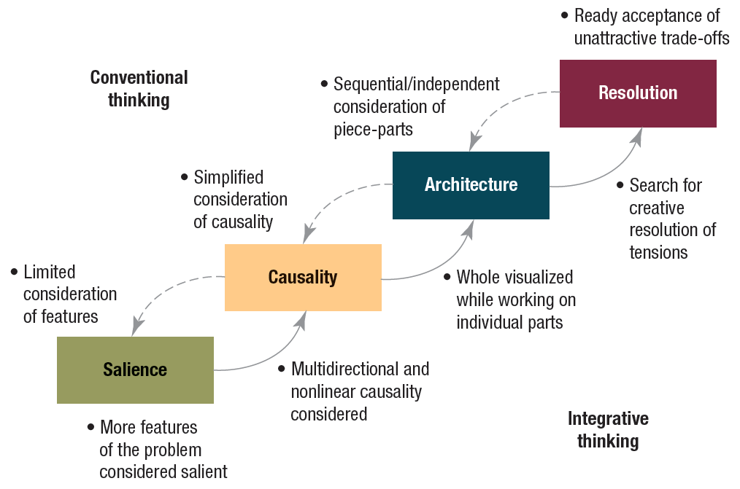
Case Analysis
Decision-Making Techniques
Exhibit 13.4 Integrative Thinking: The Process of Thinking and Deciding
Source: Reprinted by permission of Harvard Business School Press from R. L. Martin. The Opposable Mind, 2007. Copyright 2007 by the Harvard Business School Publishing Corporation; all rights reserved.
Notes:
Exhibit 13.4 outlines the four stages of the integrated thinking and deciding process, using the example of deciding where to go on vacation to illustrate the stages. Salience involves taking stock of what features of the decision you consider relevant and important. For example: where will you go? What will you see? Where will you stay? What will it cost? Is it safe? Then causality requires making a mental map of the causal relationships between the features, for example, is it worth it to invite friends to share expenses? Will an exotic destination be less safe? In the architecture stage, use the mental map to arrange a sequence of decisions that will lead to a specific outcome. For example, will you make the hotel and flight arrangements first, or focus on which sightseeing tours are available? Finally, in resolution, make your selections. For example, choose which destination, which flight, and so forth. Your final resolution is linked to how you evaluated the first three stages; if you are dissatisfied with your choices, the dotted arrows in the diagram suggest you can go back through the process and revisit your assumptions.

Slide 14
Strategic Case Analysis Process
Analyzing organizational goals & objectives
  Has the company developed short-term objectives that are inconsistent with its long-term mission?
  Has the company considered all of its stakeholders equally in making critical decisions?
  Is the company being faced with an issue that conflicts with one of its long-standing policies?
Notes:
Each of the previous 12 chapters of this book includes techniques and information that may be useful in a case analysis. Here we draw on the material presented in each of the 12 chapters to show how it informs the case analysis process. In chapter 1 we discussed how the company’s vision, mission, and objectives keep organization members focused on a common purpose. These elements also influence how an organization deploys its resources, relates to its stakeholders, and matches its short-term objectives with its long-term goals. The goals may even impact how a company formulates and implements strategies. When exploring issues of goals and objectives, while doing your case analysis you might ask the above questions.

Slide 15
Strategic Case Analysis Process
Analyzing the external environment
  Does the company follow trends and events in the general environment?
  Is the company effectively scanning and monitoring the competitive environment?
  Has the company correctly analyzed the impact of the competitive forces in its industry on profitability?
Notes:
In chapter 2 we discussed how the company’s general environment consists of demographic, socio-cultural, political/legal, technological, economic, and global conditions. The competitive environment includes rivals, suppliers, customers, and other factors that may directly affect a company’s success. Strategic managers must monitor the environment to identify opportunities and threats that may have an impact on performance. When investigating a firm’s external environment you might ask the above questions.

Slide 16
Strategic Case Analysis Process
Analyzing the internal environment
  Does the company know how the various components of its value chain are adding value to the firm?
  Has the company accurately analyzed the source and vitality of its resources?
  Is the company’s financial performance as good as or better than that of its close competitors?
Notes:
In chapter 3 we discussed how a firm’s internal environment consists of its resources and other value-adding capabilities. Value chain analysis and a resource-based approach to analysis can be used to identify a company’s strengths and weaknesses and determine how they are contributing to its competitive advantages. Evaluating firm performance can also help make meaningful comparisons with competitors. When researching a company’s internal analysis you might ask the above questions.

Slide 17
Strategic Case Analysis Process
Assessing a firm’s intellectual assets
  Does the company have underutilized human capital?
  Is the company missing opportunities to forge strategic alliances?
  Has the company developed knowledge-management systems to capture what it learns?
Notes:
In chapter 4 we discussed how human capital is a major resource in today’s knowledge economy. As a result, attracting, developing, and retaining talented workers is a key strategic challenge. Other assets such as patents and trademarks are also critical. How companies leverage their intellectual assets through social networks and strategic alliances, and how technology is used to manage knowledge may be a major influence on a firm’s competitive advantage. When analyzing a firm’s intellectual assets you might ask the above questions.

Slide 18
Strategic Case Analysis Process
Formulating business-level strategies
  Has the company chosen the correct competitive strategy given its industry environment and competitive situation?
  Does the company use combination strategies effectively?
  Is the company using a strategy that is appropriate for the industry life cycle in which it is competing?
Notes:
In chapter 5 we discussed how firms use the competitive strategies of differentiation, focus, and overall cost leadership as a basis for overcoming the five competitive forces and developing sustainable competitive advantages. Combinations of these strategies may work best in some competitive environments. Additionally, an industry’s lifecycle is an important contingency that may affect the company’s choice of business-level strategies. When accessing business-level strategies you might ask the above questions.

Slide 19
Strategic Case Analysis Process
Formulating corporate-level strategies
  Is the company competing in the right businesses given the opportunities and threats that are present in the environment?
  Is the corporation managing its portfolio of businesses in a way that creates synergies among the businesses?
  Are the motives of the top corporate executives who are pushing diversification strategies appropriate?
Notes:
In chapter 6 we discussed how firms often own and manage portfolios of businesses. Corporate strategies address methods for achieving synergies among these businesses. Related and unrelated diversification techniques are alternative approaches to deciding which business should be added to or removed from a portfolio. Companies can diversify by means of mergers, acquisitions, joint ventures, strategic alliances, and internal development. When accessing corporate-level strategies you might ask the above questions.

Slide 20
Strategic Case Analysis Process
Formulating international-level strategies
  Is the company’s entry into an international marketplace threatened by the actions of local competitors?
  Has the company made the appropriate choices between cost reduction and local adaption to foreign markets?
  Can the company improve its effectiveness by embracing one international strategy over another?
Notes:
In chapter 7 we discussed how foreign markets provide both opportunities and potential dangers for companies that want to expand globally. To decide which entry strategy is most appropriate, companies have to evaluate the trade-offs between two factors that firms face when entering foreign markets: cost reduction and local adaptation. To achieve competitive advantages, firms will typically choose one of three strategies: global, multidomestic, or transnational. When evaluating international-level strategies you might ask the above questions.

Slide 21
Strategic Case Analysis Process
Formulating entrepreneurial strategies
  Is the company engaged in an ongoing process of opportunity recognition?
  Do the entrepreneurs who are launching new ventures have vision, dedication & drive, and a commitment to excellence?
  Have strategic principles and tools such as five-forces analysis & value-chain analysis been used in the process of developing strategies to pursue the entrepreneurial opportunity?
Notes:
In chapter 8 we discussed how new ventures and jobs can create new wealth. To do so, they must identify opportunities that will be viable in the marketplace as well as gather resources and assemble an entrepreneurial team to enact the opportunity. New entrants often evoke a strong competitive response from incumbent firms in a given marketplace. When examining the role of strategic thinking on the success of entrepreneurial ventures and the role of competitive dynamics you might ask the above questions.

Slide 22
Strategic Case Analysis Process
Achieving effective strategic control
  Is the company employing the appropriate informational control systems?
  Does the company have a strong and effective culture that aligns its values & rewards system with its goals & objectives?
  Has the company implemented control systems that match its strategies?
Notes:
In chapter 9 we discussed how strategic controls enable the firm to implement strategies effectively. Informational controls involve comparing performance to stated goals and scanning, monitoring, and being responsive to the environment. Behavioral controls emerge from a company’s culture, reward systems, and organizational boundaries. When assessing the impact of strategic controls on implementation you might ask the above questions.

Slide 23
Strategic Case Analysis Process
Creating effective organizational designs
  Has the company implemented organizational structures that are suited to the type of business it is in?
  Has the company employed boundaryless organizational designs where appropriate, & do senior managers maintain appropriate control of lower-level employees?
  Does the company use outsourcing to achieve the best possible results?
Notes:
In chapter 10 we discussed how organizational designs that align with competitive strategies can enhance performance. As companies grow and change, their structures must also evolve to meet new demands. In today’s economy, firm boundaries must be flexible and permeable to facilitate smoother interactions with external parties such as customers, suppliers, and alliance partners. New forms of organizing are becoming more common. When evaluating the role of organizational structure in strategy implementation you might ask the above questions.

Slide 24
Strategic Case Analysis Process
Creating a learning organization and an ethical organization
  Do company leaders promote excellence as part of the overall culture?
  Is the company committed to being a learning organization and does it capitalize on the individual & collective talents of organizational members?
  Have company leaders exhibited an ethical attitude in their own behavior?
Notes:
In chapter 11 we discussed how strong leadership is essential for achieving competitive advantages. Two leadership roles are especially important. The first is creating a learning organization by harnessing talent and encouraging the development of new knowledge. Second, leaders play a vital role in motivating employees to excellence and inspiring ethical behavior. When exploring the impact of effective strategic leadership you might ask the above questions.

